Slide 1

Online Retail Application Database
Team Members:
Lokesh Mandarapu (116100885)
Dhairya Umrania (116084763)
Sakethram Reddy Palugulla (116065591)
Santhosh Reddy Mudiyala (115934124)

Slide 2


Introduction
This project presents a fully normalized relational database for an online retail system.
Supports customers, suppliers, products, orders, payments, and preference ranking.
Includes schema, ER design, functional dependencies, and wireframe simulation.

Slide 3
Background Knowledge
This project is an example of an Online Transaction Processing (OLTP) system.
OLTP databases are optimized for high-speed transactional workflows like ordering, inventory, and payments.
Normalization ensures minimal redundancy and strong data consistency.
Constraints help maintain integrity in real-time systems.

Slide 4
Tools Used
MySQL – for designing, creating, and managing the relational schema, to define constraints, and perform data operations.
HTML/CSS – for building static wireframes to simulate user workflows.
MermaidJS – to create and visualize the ER diagram.
GitHub – for version control and collaborative development.

Slide 5
Related Applications
This schema simulates features of real-world e-commerce platforms such as Amazon and Flipkart.
Key modules include: user authentication, product listings, supplier mapping, checkout, and admin analytics.
The preference ranking logic is similar to recommender systems based on supplier conditions.
Supports extensibility for full-stack integration and ML recommendations.

Slide 6

Project Goals
Design a clean schema for marketplace operations.
Ensure normalization and data integrity with constraints.
Enable data mining through preference index calculations.
Simulate database queries for validation.

Slide 7
Entity Highlights
customers (customer_id, user_id, password)
customer_orders (customer_order_id, customer_id, account_id, total_price)
items (item_id, name), class (class_id, item_id, class_type, max_price)
supplier_items (commission, discount, stock, review)
Notes:
Item_class = item categories like Electronics, Clothing, Household items, etc

Slide 8
Entity-Relationship Summary
customers → accounts, orders
orders → order_items → suppliers, items, class
items → class, supplier_items
supplier_items → preference_index
Supports many-to-many, specialization, and dependent relationships.
Notes:
Preference_index = a metric to calculate which supplier to prioritize, we will explain this in depth later on
Many-to-many relationships (like items belonging to multiple item classes)
Specialization (like how items are categorized)
Dependent relationships (like how order_items depend on orders)

Slide 9
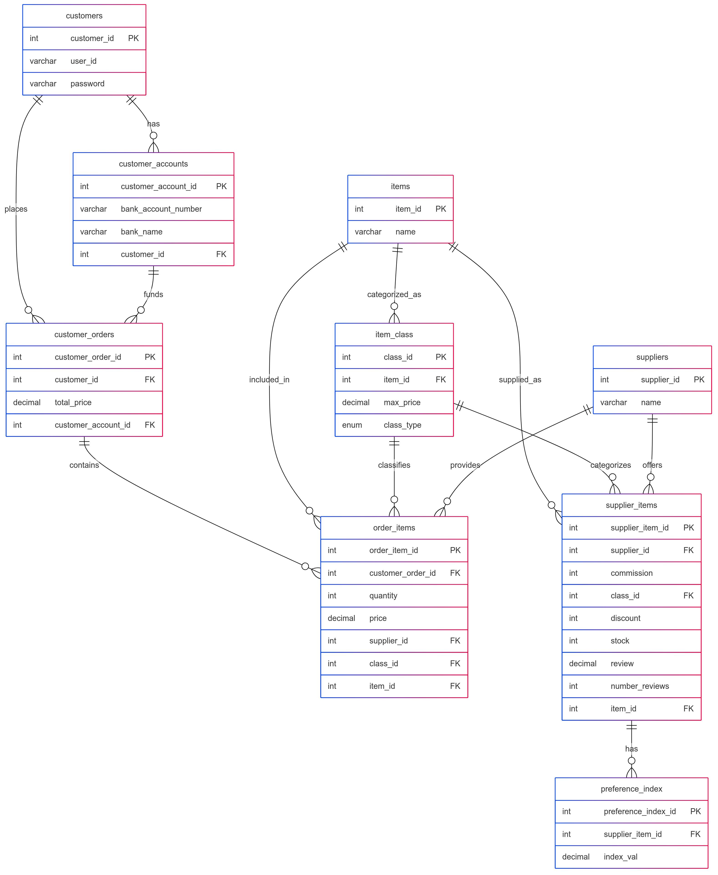
Notes:
Introduction
"This diagram represents our database structure for our order management system. It shows how customer information, accounts, orders, items, and suppliers are interconnected."
Core Entities (starting with the customer journey)
"Let's follow the customer journey through our system:
The customers table stores basic user information including IDs and authentication details
Customers can have multiple customer_accounts with different banking information
Customers place customer_orders using funds from their accounts
Orders contain multiple order_items with specific quantities and prices"
Product Catalog Structure
"On the product side:
The items table is our main product catalog
Products are organized through the item_class table, providing categorization
Each item can belong to multiple classes, creating a flexible taxonomy"
Supply Chain Relationships
"The supplier relationships are modeled through:
The suppliers table containing our vendor information
supplier_items linking products to their sources
This table also tracks inventory, pricing, commissions, and customer reviews
The preference_index table appears to track supplier performance metrics"

Slide 10
ER Diagram Overview
Customers can have multiple accounts and place multiple orders.
Each order is funded through a customer account and contains multiple items.
Items are classified by type (A, B, C) and connected to suppliers via supplier_items.
order_items links customer orders with specific items, suppliers, and class.
supplier_items table records commission, discount, stock, and review.
Each supplier_item entry has a computed preference_index.
ER diagram represents all relationships and enforces FK-based integrity.

Slide 11
Schema Overview
9 core tables: customers, accounts, orders, items, class, suppliers, order_items, supplier_items, preference_index.
Relational links ensure proper mapping and constraints for referential integrity.
Supports item classification, supply mapping, and ranked preferences.
In-depth Schema present on GitHub.
Notes:
The next step after mapping out out ER diagram was to make a schema to represent how we would make it in the database.
Github: We have created the full relational schema and it’s SQL code for creating all the tables here. We will share our Github link in case you want to see the schema or configure your own database using our queries. We have a few sample queries later on in the presentation that we will showcase which are using the schema and the tables we created

Slide 12
Functional Dependencies
customer_id → user_id, password
order_id → customer_id, total_price
supplier_item_id → commission, review, discount
item_id, class_type → class_id

Slide 13
Key Algorithms
Preference Index Calculation uses a sigmoid-like transformation:
Formula: 1 / (1 + exp(-1 * (commission + review + discount)))
Higher discount and lower commission/review improve ranking.
This can be extended to more advanced scoring like collaborative filtering.

Slide 14
Preference Index Calculation
Formula: 1 / (1 + exp(-1 * (commission + review + discount)))
Business Rules:
- Function: Calculate_preference_index(commission, review, discount)
- Trigger auto-updates index when commission, review, or discount changes
- Each item must belong to a class A, B, or C with pricing limits
- Orders are linked to specific customer accounts for payment
- Order items connect orders to specific classed products and suppliers

Slide 15

Application Flow (Wireframes)
Login/Register, Product Listings with Filters
Cart, Checkout using customer bank accounts
Order history, Supplier product editor, Admin management
Real-time analytics, top items, top suppliers
Notes:
Show walkthrough using wireframes
For Login, explain validation
Relate each page to DB

Slide 16
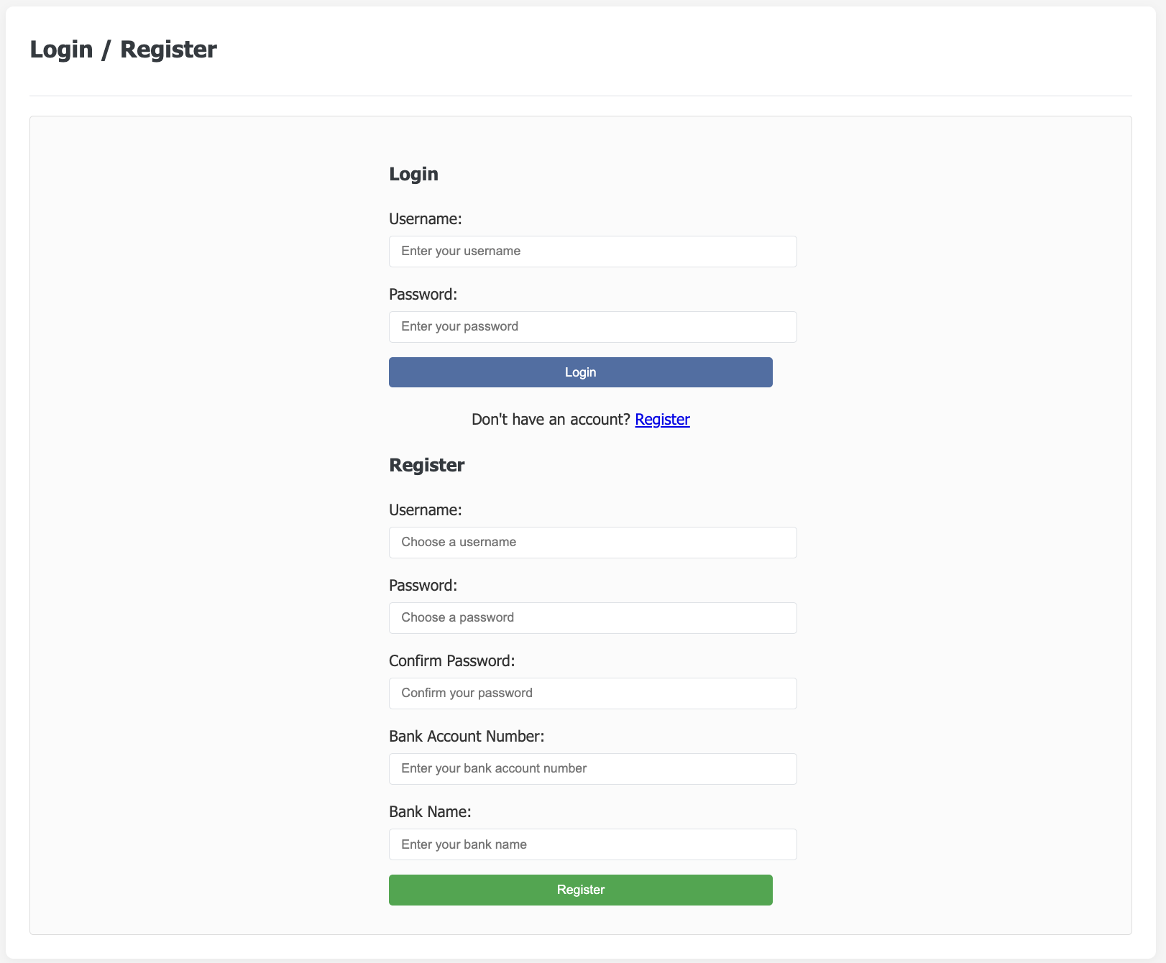

Slide 17
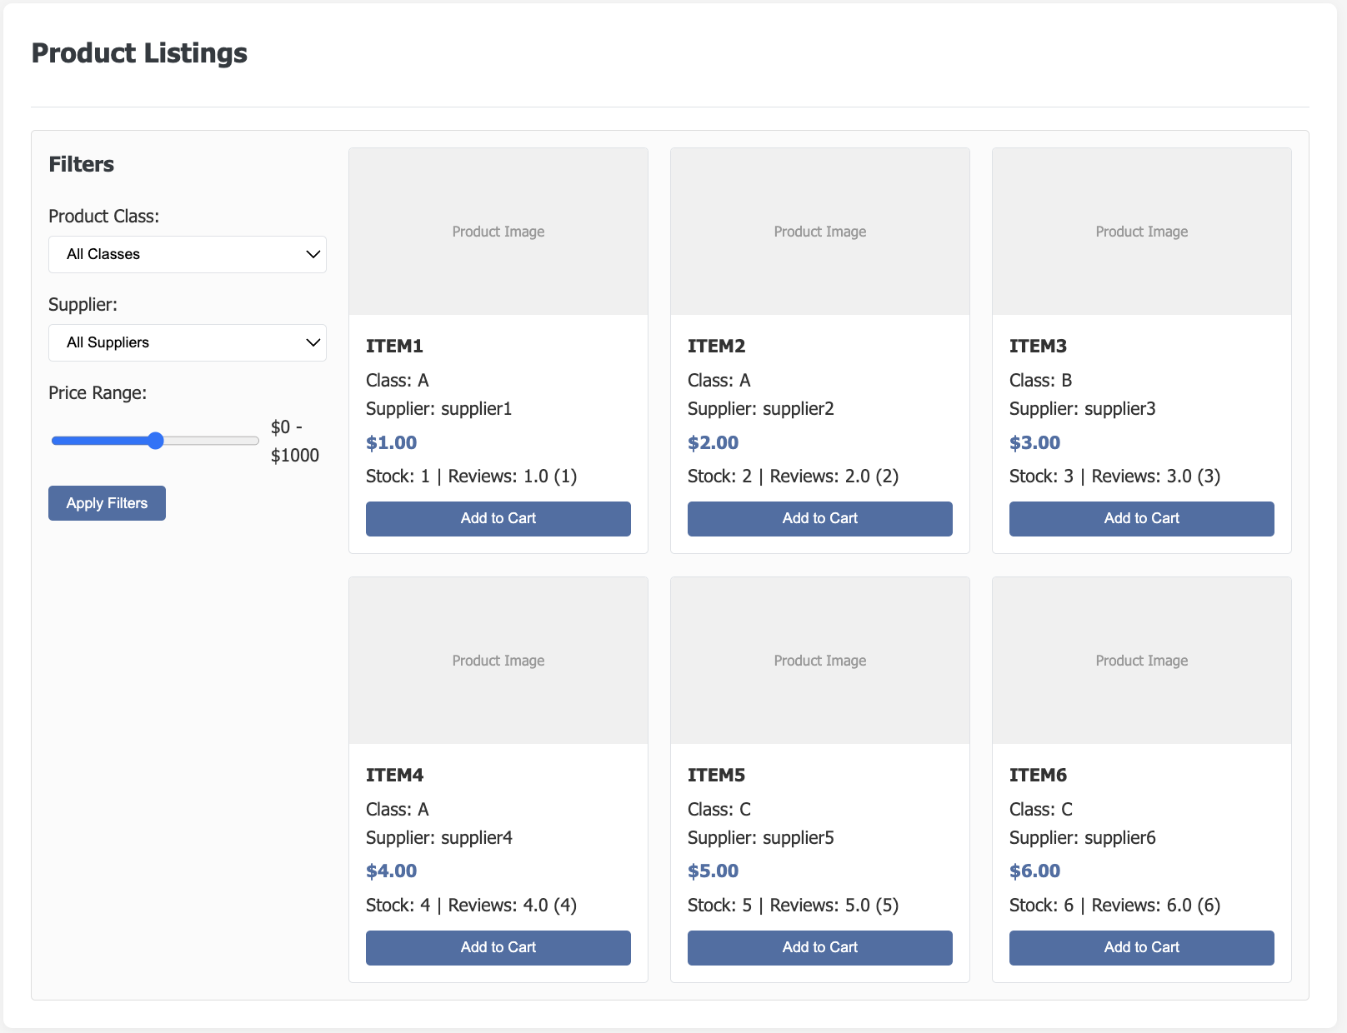

Slide 18
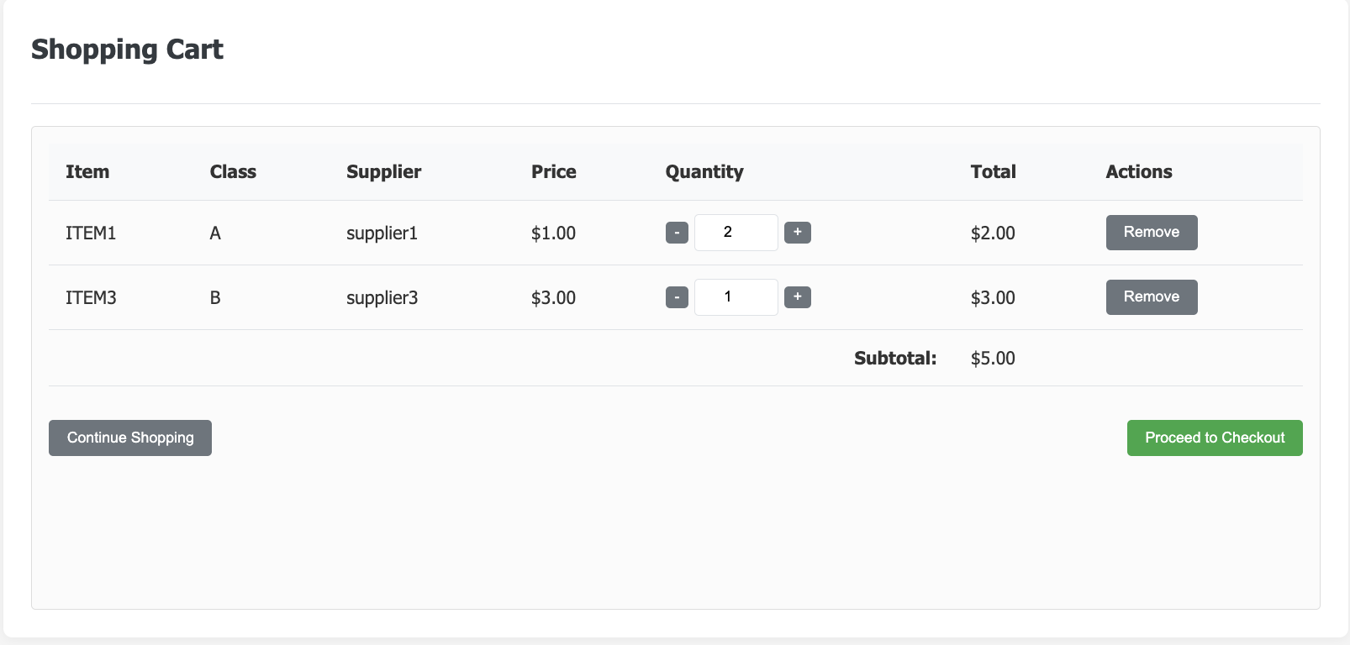
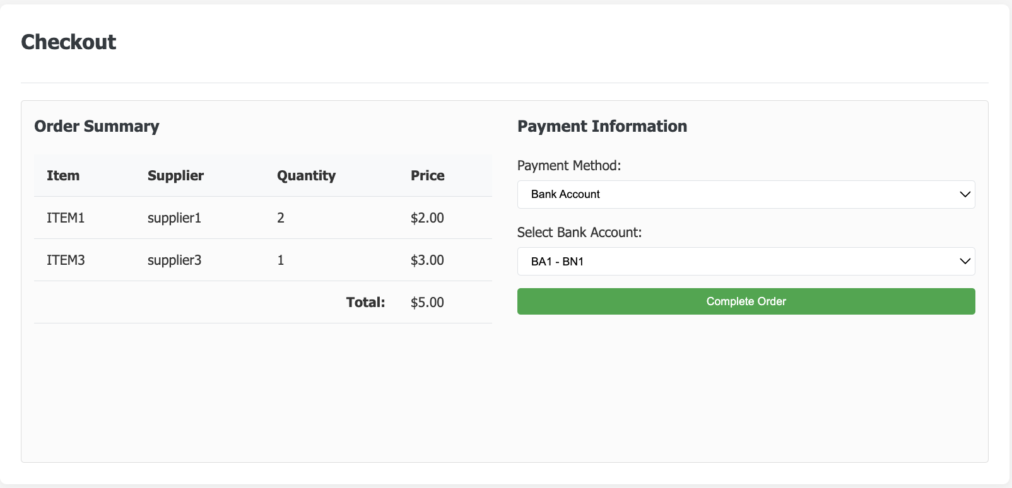

Slide 19
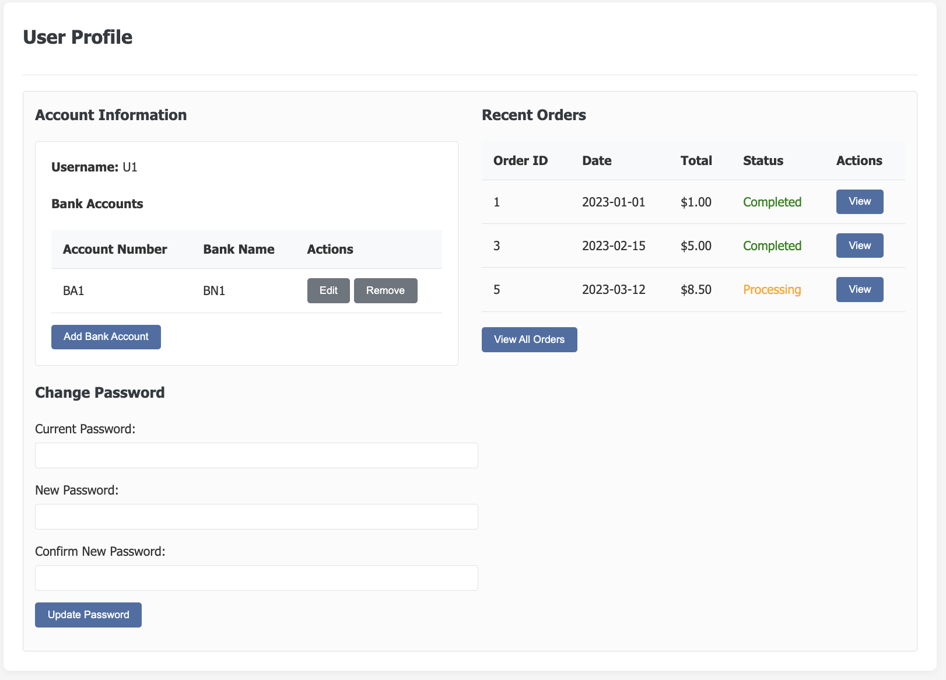

Slide 20
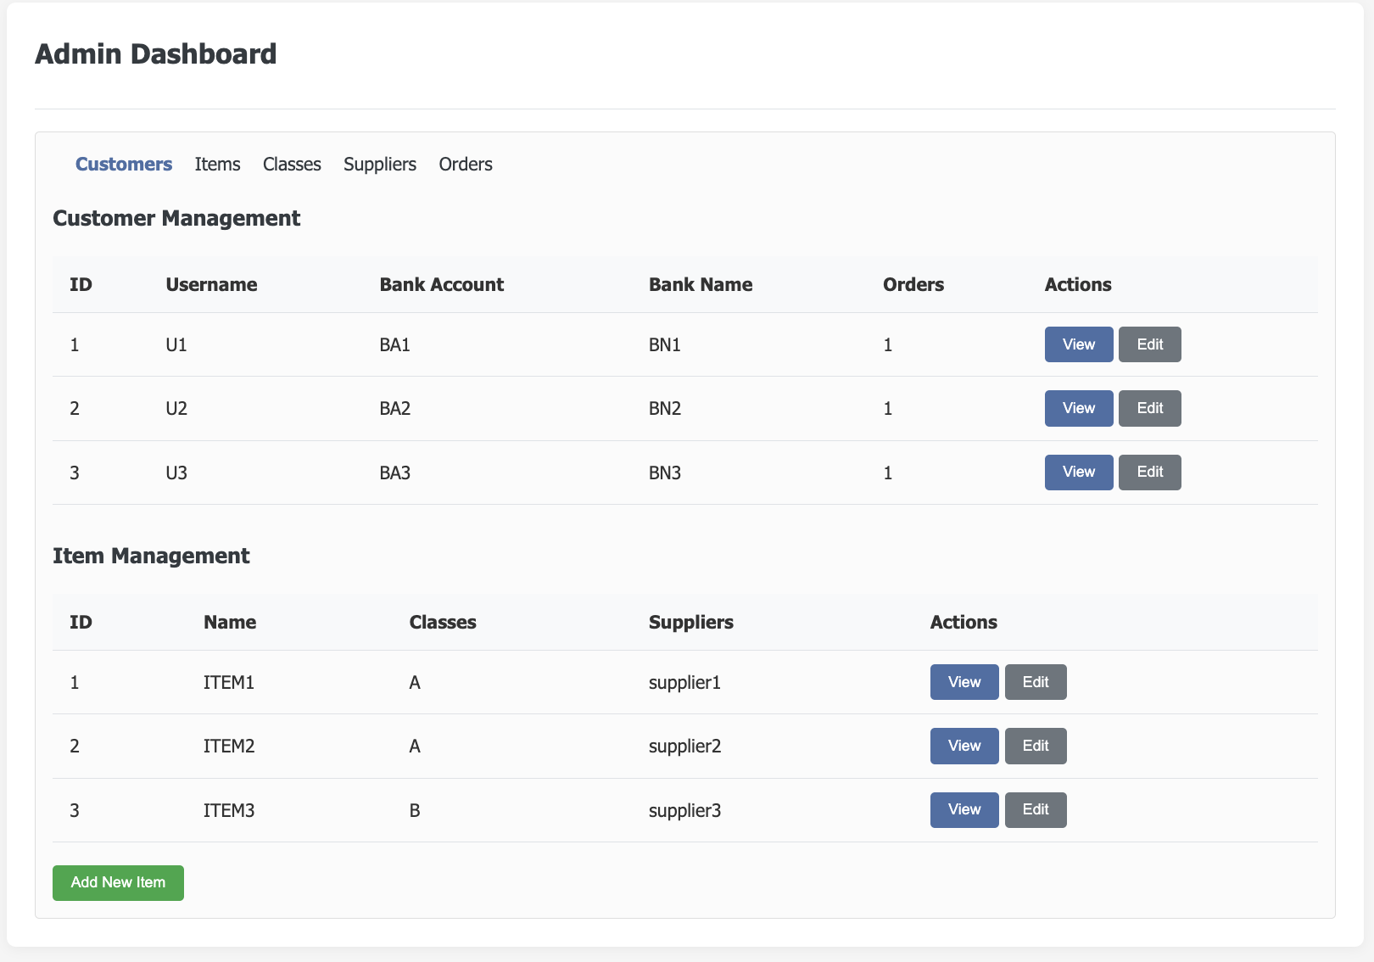

Slide 21
Comparison with Other Approaches
Why relational database?
- Ensures ACID compliance, normalization, and SQL querying.
Why not NoSQL?
- NoSQL offers flexibility but may sacrifice integrity and consistency.

Slide 22
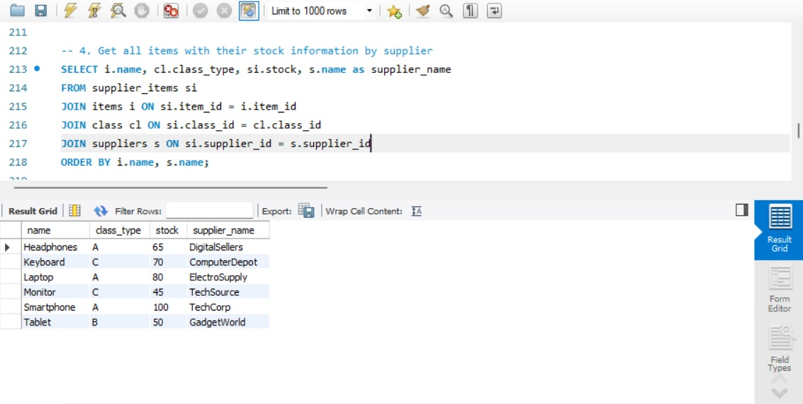
Sample SQL Queries & Outputs
Notes:
Showcase in DB

Slide 23
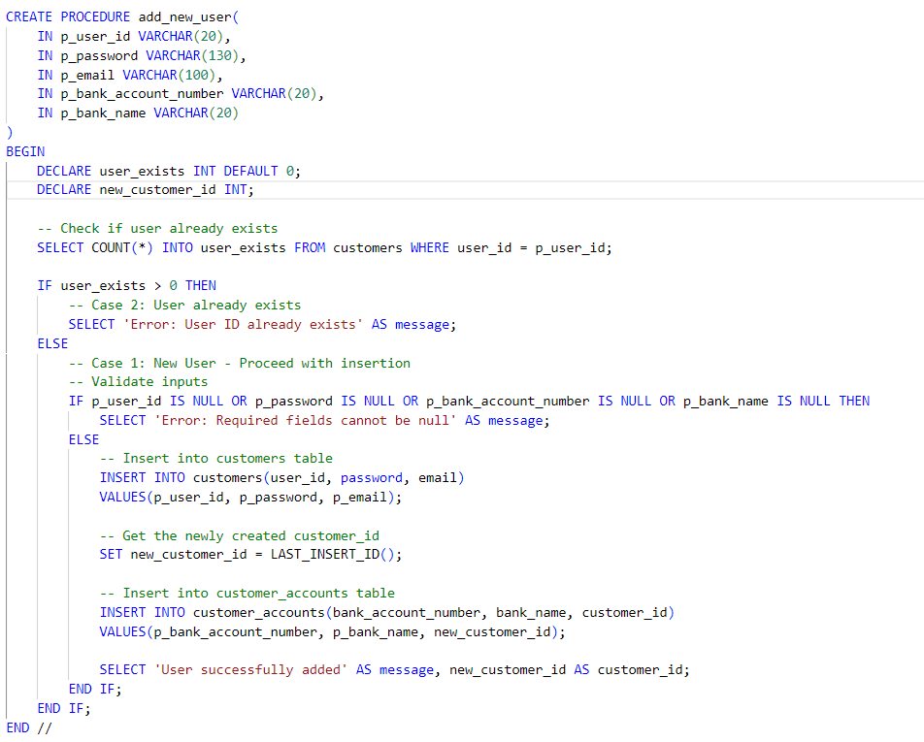

Slide 24
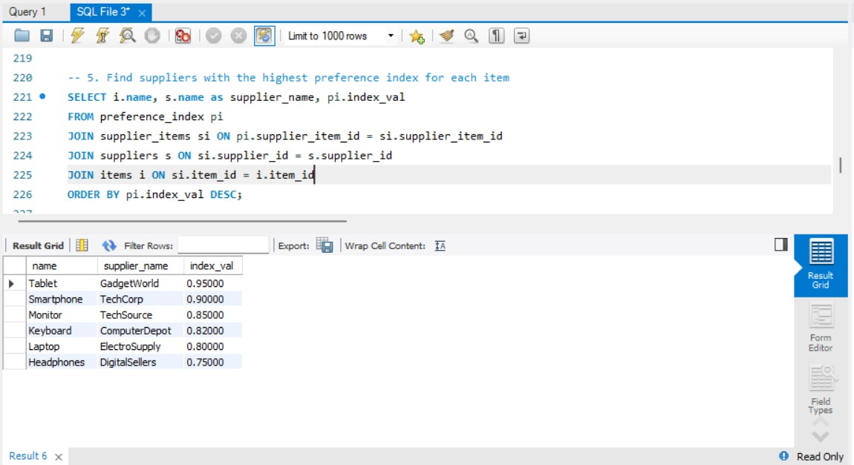
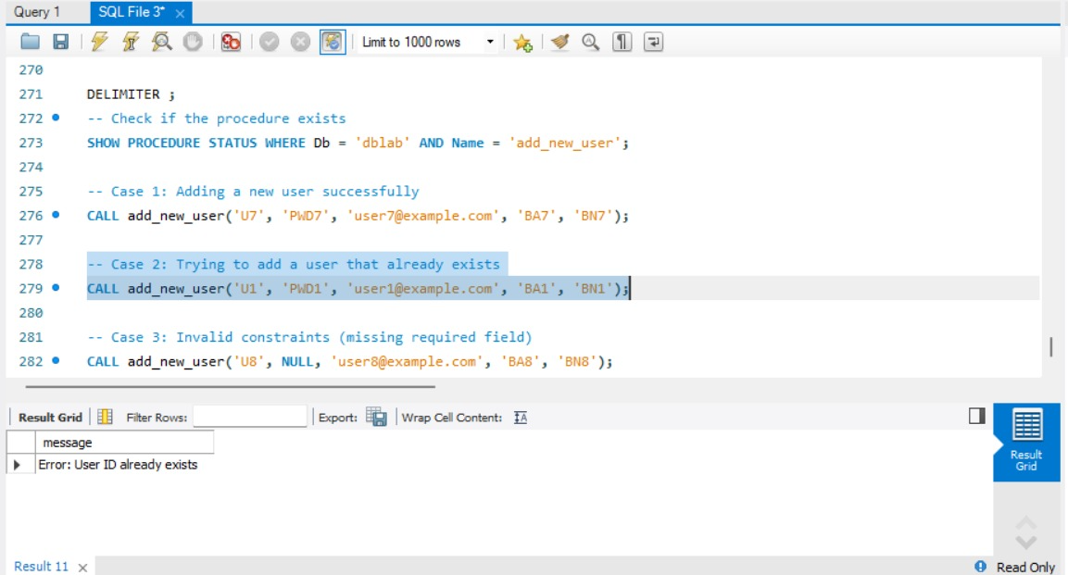

Slide 25
User Guide
1. Clone the schema and data SQL file from GitHub. https://github.com/DhairyaUmrania/DataManagementProject
2. Run the SQL script in MySQL to set up tables and insert data.
3. Open wireframes.html to explore frontend views.
4. Query the database using provided SQL examples.
5. Extend wireframes with backend calls for full integration.

Slide 26

Project Summary
Comprehensive schema for marketplace operations.
Preference logic enables advanced data mining.
Wireframes ensure end-to-end flow validation.
Supports integration with frontend and analytics tools.

Slide 27
Next Steps
Incorporate recommendation engine using ML.
Expand to real-time order and inventory tracking.
Develop frontend using React or Vue.
Deploy full-stack application with cloud DB.

Slide 28

Team Contributions
Santhosh - ER Diagram
Dhairya - SQL Queries
Lokesh - Wireframes
Sakethram - Testing & Documentation

Slide 29

THANK YOU
Questions and Feedback Welcome

